Slide 1

Cascading Style Sheet
CSS

Slide 2
Content
Introduction
CSS Syntax
CSS Selectors
<div> tag

Slide 3
Introduction
CSS is the language we use to style a Web page
CSS stands for Cascading Style Sheets
CSS describes how HTML elements are to be displayed on screen, paper, or in other media
CSS can control the layout of multiple web pages all at once
External stylesheets are stored in CSS files

Slide 4
Why to use CSS
CSS is used to define
Styles for web pages
The design, layout and variations in display for different devices and screen sizes
CSS removed the style formatting from the HTML page
The style definitions are normally saved in external .css files.
With an external stylesheet file, you can change the look of an entire website by changing just one file!

Slide 5
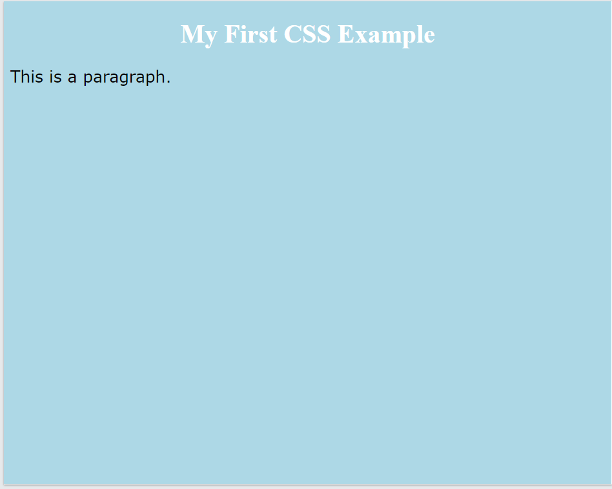
CSS Example
<!DOCTYPE html> <html lang = "en-US"> <head> <style>
body { background-color: lightblue; }
h1 { color: white; text-align: center; }
p { font-family: verdana; font-size: 20px; }
</style> </head>
<body>
<h1>My First CSS Example</h1> <p>This is a paragraph</p>
</body>
</html>

Slide 6
CSS Syntax
A CSS rule consists of a selector and a declaration block.
h1 { color:blue; font-size:12px; }
The selector points to the HTML element you want to style.
h1 is selector
The declaration block contains one or more declarations separated by semicolons.
Each declaration includes a CSS property name and a value, separated by a colon.
Properties are color, font-size
The values are blue, 12px
Multiple CSS declarations are separated with semicolons, and declaration blocks are surrounded by curly braces.

Slide 7
CSS Syntax
<!DOCTYPE html> <html lang = "en-US"> <head> <style>
p { color: red; text-align: center; }
</style> </head>
<body>
<h1> Hello World! </h1> <p>These paragraphs are styled with CSS</p>
</body>
</html>
p is a selector in CSS (it points to the HTML element you want to style: <p>).
color is a property, and red is the property value
text-align is a property, and center is the property value

Slide 8
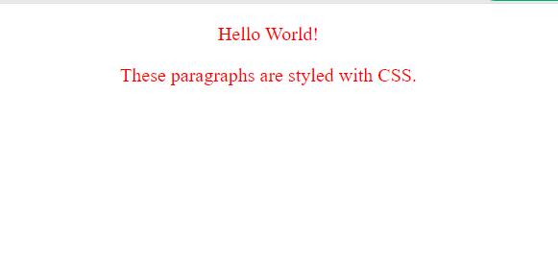
CSS Syntax
<!DOCTYPE html> <html lang = "en-US"> <head> <style>
p { color: red; text-align: center; }
</style> </head>
<body>
<p> Hello World! </p> <p>These paragraphs are styled with CSS</p>
</body>
</html>

Slide 9
CSS Selectors
CSS selectors are used to "find" or select the HTML elements we want to style.
CSS selectors are divided into five categories:
Simple selectors: Select elements based on name, id, class
Combinator selectors: Select elements based on a specific relationship between them
Pseudo-class selectors: Select elements based on a certain state
Pseudo-elements selectors: Select and style a part of an element
Attribute selectors: Select elements based on an attribute or attribute value

Slide 10
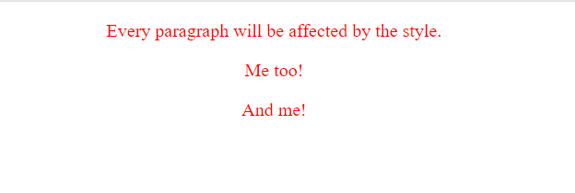
CSS Selectors
<!DOCTYPE html> <html lang = "en-US"> <head> <style>
p { color: red; text-align: center; }
</style> </head>
<body>
<p>Every paragraph will be affected by the style</p>
<p id = ”para1”> Me too !</p>
<p>And me</p>
</body>
</html>
The CSS Element Selector
The element selector selects HTML elements based on the element name.
Here, all <p> elements on the page will be center-aligned, with a red text color

Slide 11
CSS Selectors
<!DOCTYPE html> <html lang = "en-US"> <head> <style>
#para1 { color: red; text-align: center; }
</style> </head>
<body>
<p>This paragraph is not affected by the style</p>
<p id = ”para1”> Hello World</p>
</body>
</html>
The CSS id Selector
The id selector uses the id attribute of an HTML element to select a specific element.
The id of an element is unique within a page, so the id selector is used to select one unique element!
To select an element with a specific id, write a hash (#) character, followed by the id of the element.
An id name can’t start with a number

Slide 12
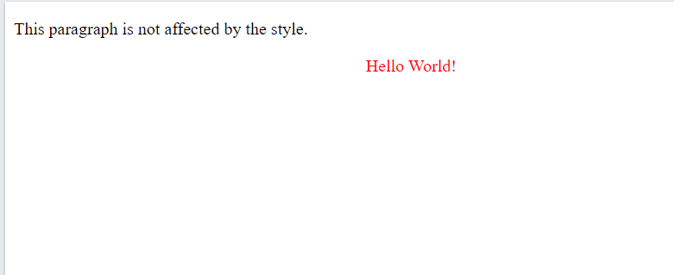
CSS Selectors
<!DOCTYPE html> <html lang = "en-US"> <head> <style>
#para1 { color: red; text-align: center; }
</style> </head>
<body>
<p>This paragraph is not affected by the style</p>
<p id = ”para1”> Hello World</p>
</body>
</html>

Slide 13
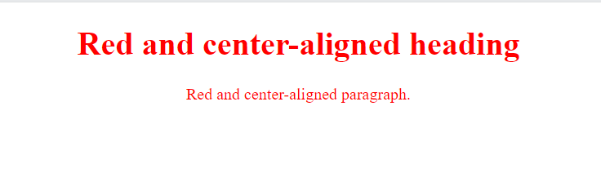
CSS Selectors
<!DOCTYPE html> <html lang = "en-US"> <head> <style>
.center { color: red; text-align: center; }
</style> </head>
<body>
<h1 class = ”center” > Red and Center aligned Heading </h1>
<p class = ”center” > Red and Center aligned Paragraph </p>
</body>
</html>
The CSS class Selector
The class selector selects HTML elements with a specific class attribute.
To select elements with a specific class, write a period (.) character, followed by the class name.
In this example all HTML elements with class="center" will be red and center-aligned:

Slide 14
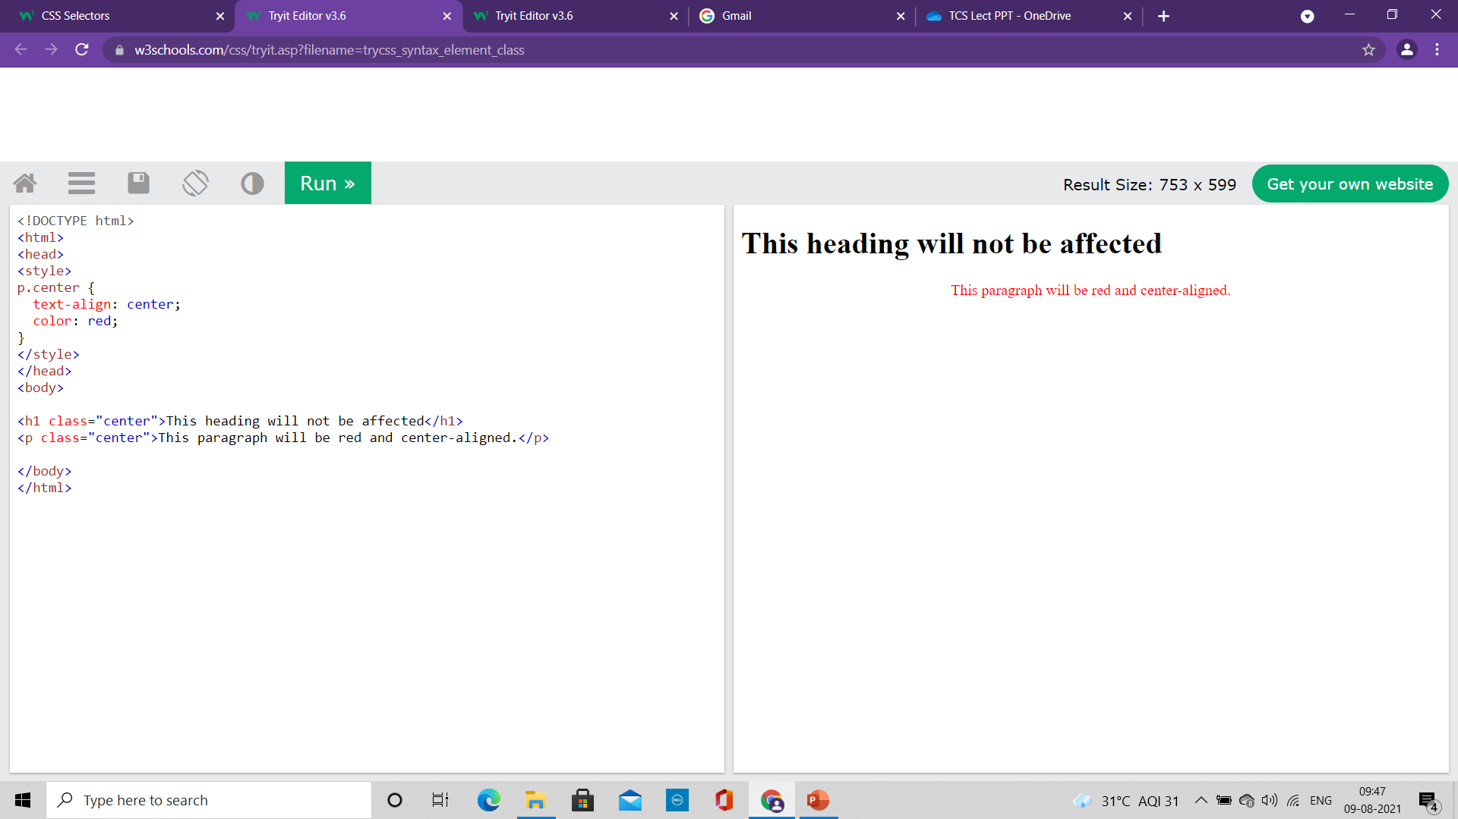
CSS Selectors
<!DOCTYPE html> <html lang = "en-US"> <head> <style>
p.center { color: red; text-align: center; }
</style> </head>
<body>
<h1 class = ”center” > This Heading will not be affected </h1>
<p class = ”center” > Red and Center aligned Paragraph </p>
</body>
</html>
The CSS class Selector
Only specific HTML elements can be specified that should be affected by a class.
In this example only <p> elements with class="center" will be red and center-aligned

Slide 15
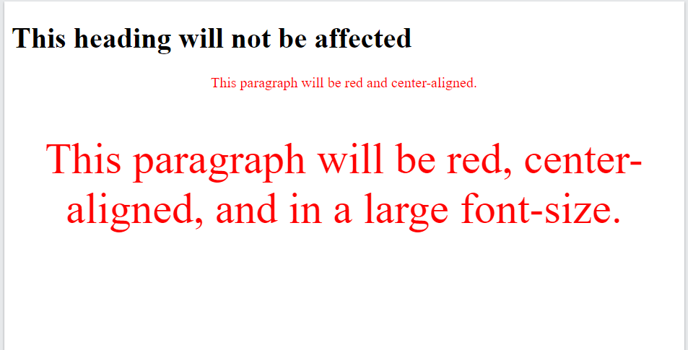
CSS Selectors
<!DOCTYPE html> <html lang = "en-US"> <head> <style>
p.center { color: red; text-align: center; }
p.large { font-size: 300%; }
</style> </head>
<body>
<h1 class = ”center” > This Heading will not be affected </h1>
<p class = ”center” > This paragraph will be red and center-aligned </p>
<p class = ”center large” > This paragraph will be red, center-aligned and in large font-size </p>
</body>
</html>
The CSS class Selector
HTML elements can also refer to more than one class.
In this example the <p> element will be styled according to class="center" and to class="large“
A class name cannot start with a number!

Slide 16
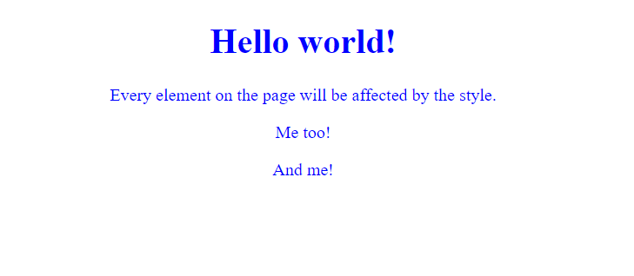
CSS Selectors
<!DOCTYPE html>
<html>
<head>
<style>
* {
text-align: center;
color: blue;
}
</style>
</head>
<body>
<h1>Hello world!</h1>
<p>Every element on the page will be affected by the style.</p>
<p id="para1">Me too!</p>
<p>And me!</p>
</body>
</html>
The CSS Universal Selector
The universal selector (*) selects all HTML elements on the page.
The CSS rule below will affect every HTML element on the page:

Slide 17
CSS Selectors
<!DOCTYPE html>
<html>
<head>
<style>
h1, h2, p {
text-align: center;
color: red;
}
</style>
</head>
<body>
<h1>Hello World!</h1>
<h2>Smaller heading!</h2>
<p>This is a paragraph.</p>
</body>
</html>
The CSS Grouping Selector
The grouping selector selects all the HTML elements with the same style definitions.
In the CSS code, the h1, h2, and p elements have the same style definitions
h1 {
text-align: center;
color: red;
}
h2 {
text-align: center;
color: red;
}
p {
text-align: center;
color: red;
}

Slide 18
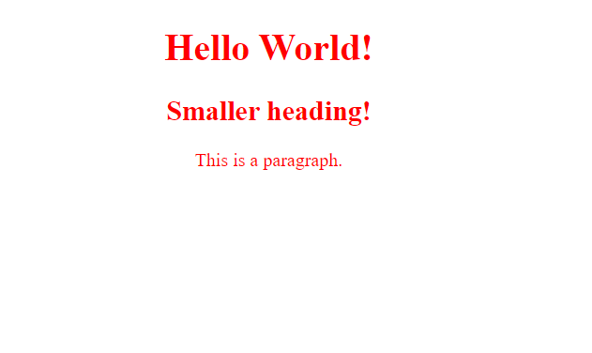
CSS Selectors
<!DOCTYPE html>
<html>
<head>
<style>
h1, h2, p {
text-align: center;
color: red;
}
</style>
</head>
<body>
<h1>Hello World!</h1>
<h2>Smaller heading!</h2>
<p>This is a paragraph.</p>
</body>
</html>
The CSS Grouping Selector
It will be better to group the selectors, to minimize the code.
To group selectors, separate each selector with a comma.

Slide 19
CSS Selectors
All CSS Simple Selectors
Selector Example Example description
#id #firstname Selects the element with id="firstname"
.class .intro Selects all elements with class="intro"
element.class p.intro Selects only <p> elements with class="intro"
* * Selects all elements
element p Selects all <p> elements
element,element,.. div, p Selects all <div> elements and all <p> elements

Slide 20
The <div> tag
The <div> tag defines a division or a section in an HTML document.
The <div> tag is used as a container for HTML elements - which is then styled with CSS or manipulated with JavaScript.
The <div> tag is easily styled by using the class or id attribute.
Any sort of content can be put inside the <div> tag!
By default, browsers always place a line break before and after the <div> element.

Slide 21
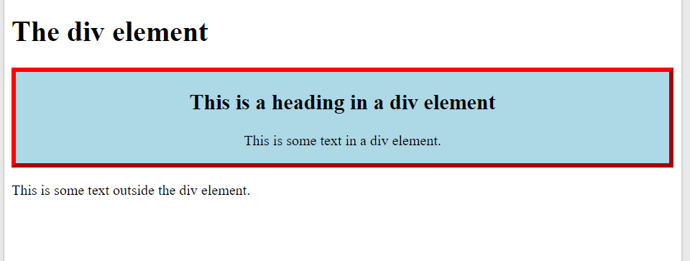
<div> Element
<!DOCTYPE html>
<html>
<head>
<style>
.myDiv {
border: 5px outset red;
background-color: lightblue;
text-align: center;
}
</style>
</head>
<body>
<h1>The div element</h1>
<div class="myDiv">
<h2>This is a heading in a div element</h2>
<p>This is some text in a div element.</p>
</div>
<p>This is some text outside the div element.</p>
</body>
</html>

